Slide 1
ECOM & CO.
DATA ANALYSIS
FROM QUERIES TO CLARITY
KHUSHI JAGNANI

Slide 2

ECOM & CO.
PROBLEM STATEMENT
The dataset represents an e-commerce platform’s sales transactions, capturing customer demographics, purchase details, payment methods, delivery performance, and profitability metrics. The objective is to analyze customer behavior, product performance, sales distribution, and profitability trends to derive actionable insights for business growth and operational efficiency

Slide 3
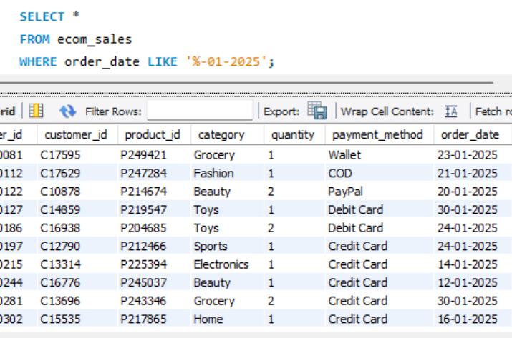


ECOM & CO.
MONTHLY ORDER INSIGHTS
Retrieving all details of orders placed in January 2025.
Helps understand recent customer activity and seasonal demand patterns.
Used function pattern matching in where clause

Slide 4
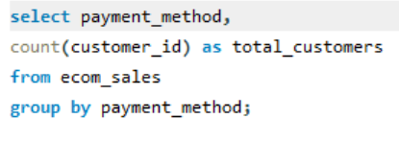
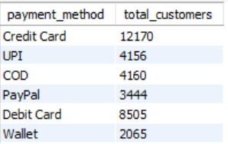
ECOM & CO.
PAYMENT PREFERENCES
Listed the unique payment methods used by customers.
It Shows the diversity of payment methods, useful for optimizing checkout options
Page 04

Slide 5
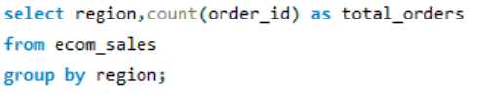
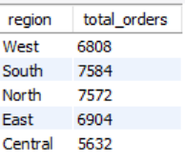
ECOM & CO.
REGIONAL SALES DISTRIBUTION
Found the total number of orders placed in each region.
Identifies strong and weak regions for targeted marketing.
Page 05

Slide 6
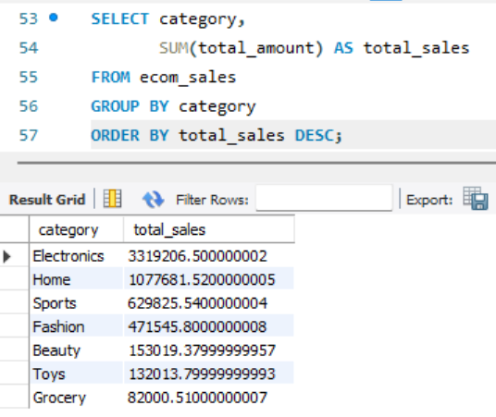
ECOM & CO.
CATEGORY-WISE SALES
Calculated the total sales (sum of total_amount) for each category.
Reveals the top-selling categories, guiding inventory and promotions.

Slide 7
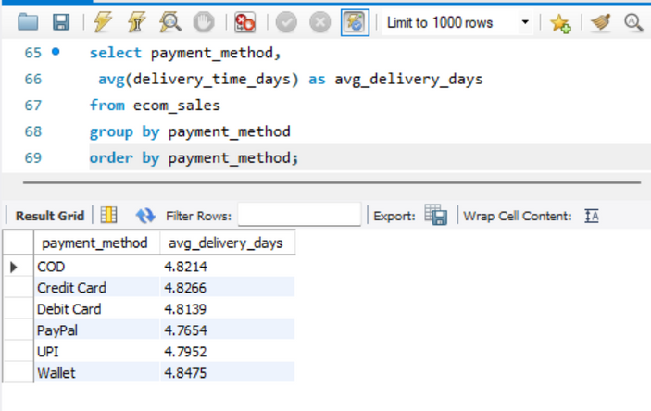
ECOM & CO.
DELIVERY PERFORMANCE
Find the average delivery time for each payment method.
Shows how delivery efficiency varies by payment type, useful for logistics.
Page 07

Slide 8
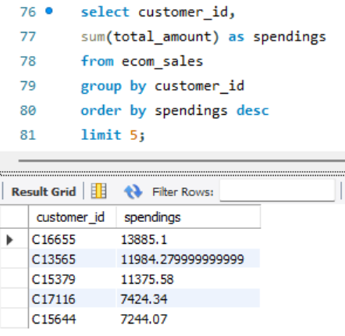
ECOM & CO.
HIGH-VALUE CUSTOMERS
Get the top 5 customers who spent the most overall
Helps identify VIP customers for loyalty programs.

Slide 9
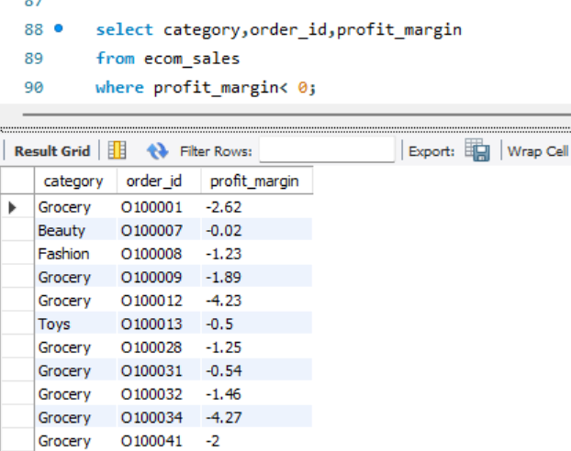
ECOM & CO.
LOSS-MAKING SALES
Retrieve orders where the profit_margin is negative.
Pinpoints unprofitable orders, helping in price/discount strategy

Slide 10
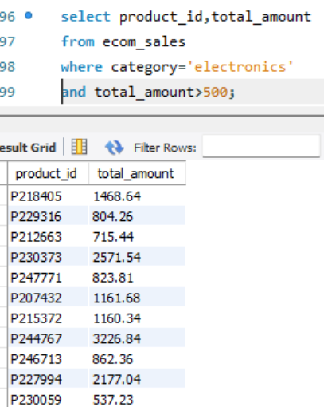
ECOM & CO.
ELECTRONICS PREMIUM PRODUCTS
List all products in the Electronics category with a price greater than ₹500.
Identifies high-value products in a competitive category.

Slide 11
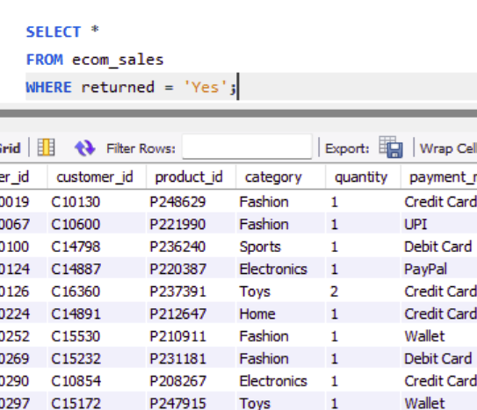
ECOM & CO.
RETURNS ANALYSIS
Find orders where the product was returned.
Helps understand return trends, which impact profit and customer satisfaction.

Slide 12
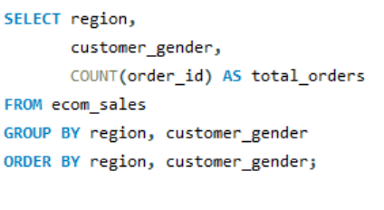
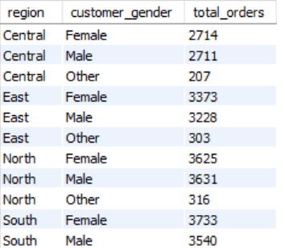
ECOM & CO.
GENDER & REGION ORDER PATTERNS
Get the number of orders placed by each customer gender, grouped by region.
Shows demographic buying patterns across regions for targeted campaigns.
Page

Slide 13
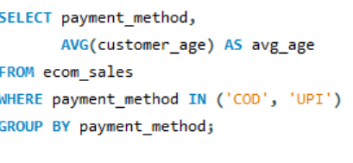
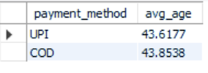
ECOM & CO.
PAYMENT METHOD VS CUSTOMER AGE
Find the average age of customers who used COD vs UPI
Reveals demographic preferences for payment types.
Page 09

Slide 14
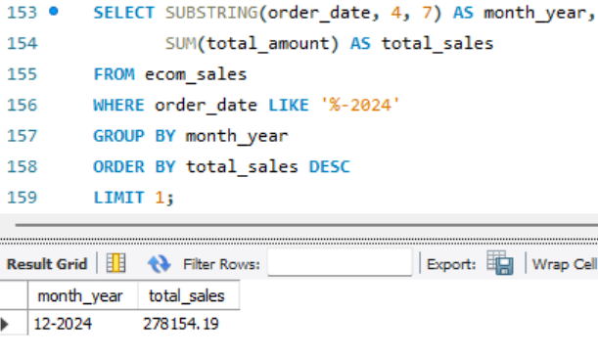
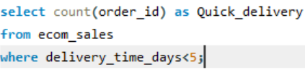
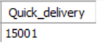
ECOM & CO.
QUICK DELIVERIES AND PEAK SALES MONTH
Count how many orders were delivered in less than 5 days.
Insight: Shows efficiency in fast delivery and customer satisfaction potential.
Find the month with the highest total sales in 2024.
Insight: Helps track seasonal peaks and plan promotions accordingly.
Page 09

Slide 15
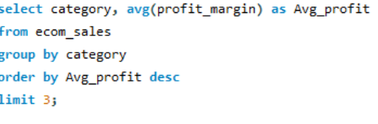
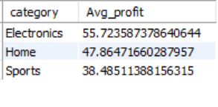
ECOM & CO.
PROFIT-HEAVY CATEGORIES
Identify the top 3 categories with the highest profit margin.
Guides business to focus on highly profitable categories.

Slide 16
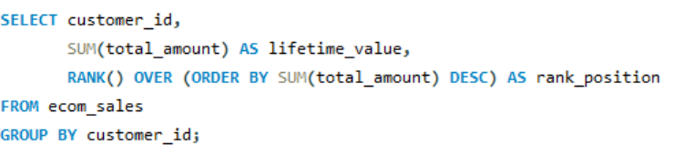
ECOM & CO.
CUSTOMER LIFETIME VALUE (CLV)
Calculate the sum of total_amount per customer and rank them
Identifies high-value customers for retention and engagement strategies.

Slide 17
ECOM & CO.
CONCLUSION
Top Categories: Electronics & Home lead in revenue.
Low Performance: Grocery & Toys have lowest sales; Grocery shows negative profit margin.
Regional Trends: South & North dominate sales; Central is weakest.
Seasonality: December is peak month (holiday-driven).
Customer Behavior: Fashion has highest returns; older customers prefer COD.
Delivery: Average 4.8 days; East region is slowest.

Slide 18
ECOM & CO.
SUGGESTIONS
Recommendations for Growth
Focus on high-margin categories (Electronics, Home) to scale profits.
Re-evaluate Grocery pricing & supply chain to reduce losses.
Improve Fashion returns with better sizing guides & quality checks.
Enhance delivery speed in East region to improve satisfaction.
Boost Central region sales via promotions & marketing campaigns

Slide 19

ECOM & CO.
THANK YOU
FOR YOUR NICE ATTENTION

